Slide 1
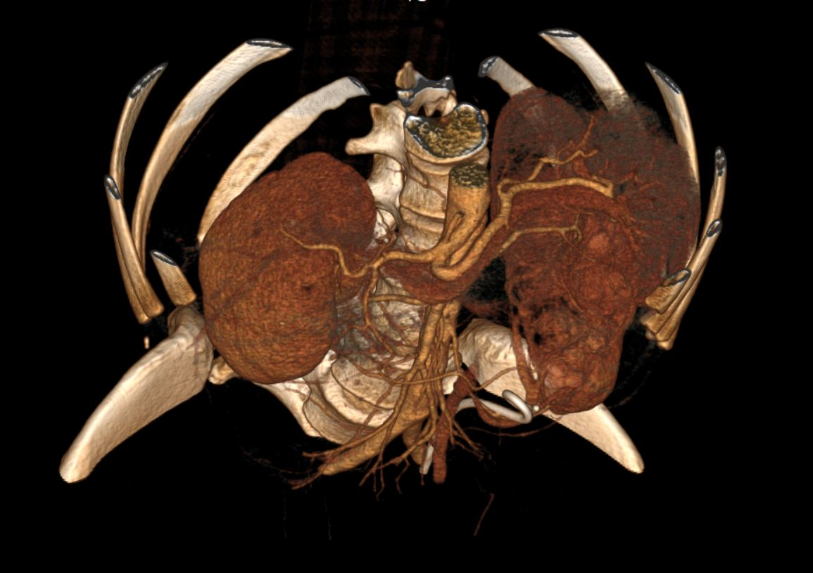
Lesion Detection and Analysis in CT Scan
FYP PROJECT Members
Slahuddin ch - 16I-0060 Abdul Masood - 16I-0312
Hajra khan - 16I-0326
Supervised By
DR. MUhammad Adnan TARIQ

Slide 2
Overview
Problem Statement
Time consuming analysis of a single CT scan image.
Inefficient utilization of CT Machine
Redundant analysis of similar cases by radiologist
Solution
Automatic lesion detection and analysis
The project does not intend to replace radiologists rather it makes their job easier and efficient.

Slide 3
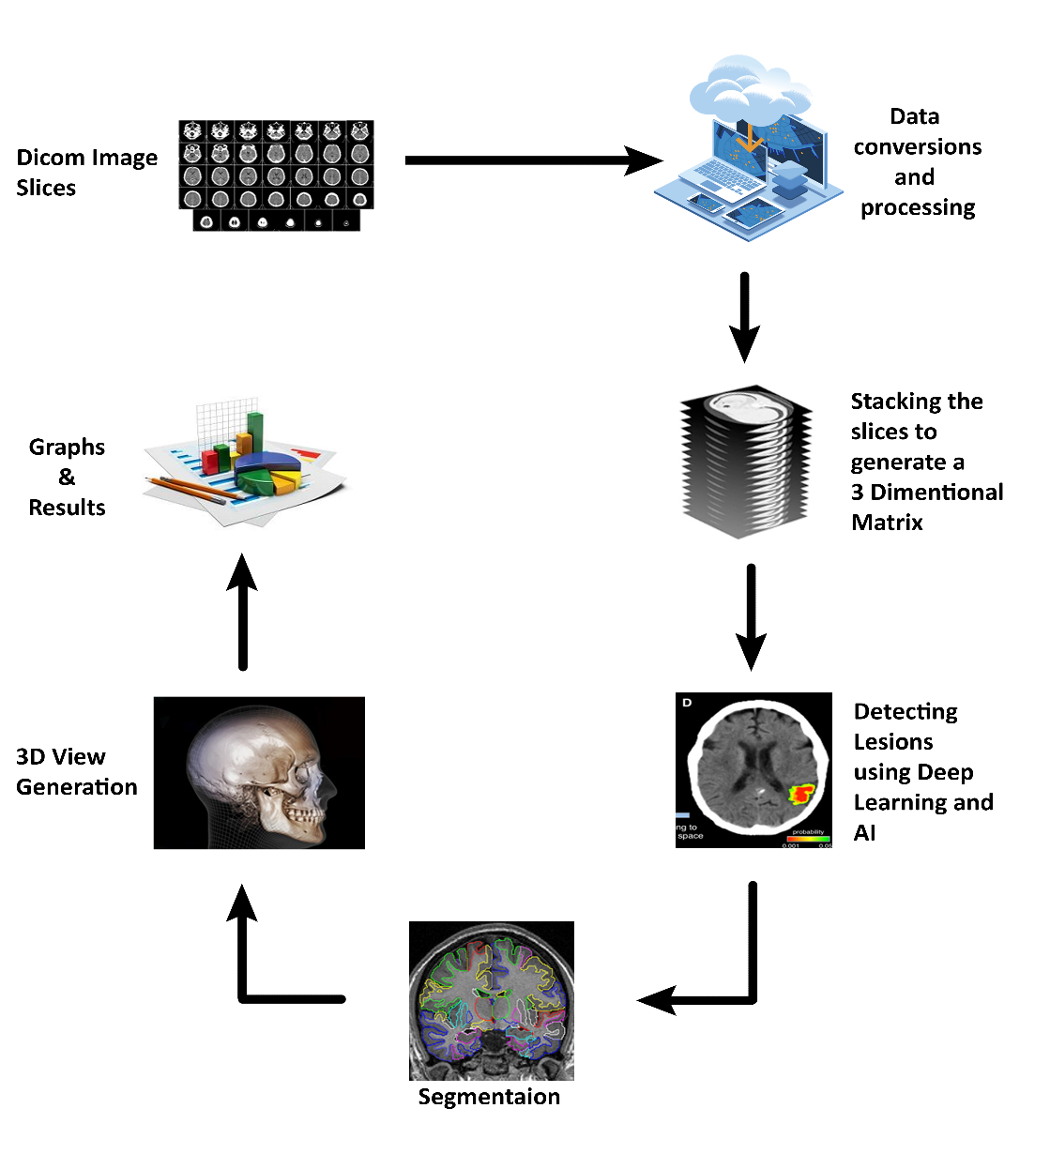
Project Process Flow Diagram

Slide 4
Work done since FYP-I Mid Evaluation
Segmentation of lesion
Model Training
Mask Generation
Frontend Development

Slide 5
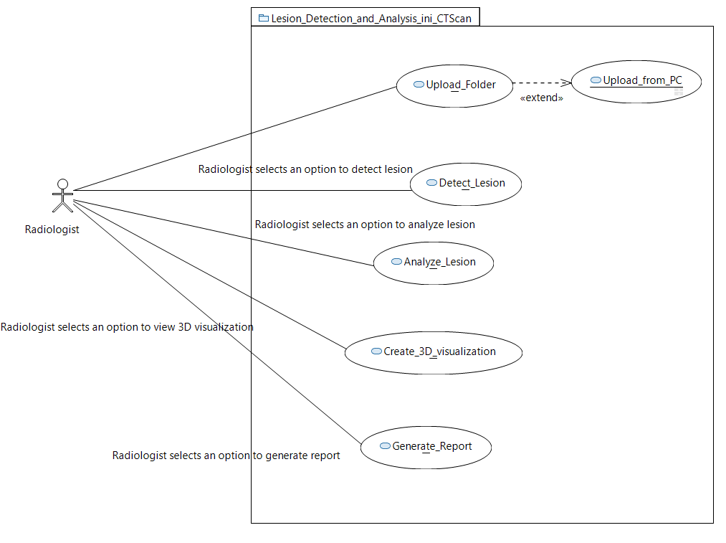
Use case diagram

Slide 6
Work to be done in FYP-II
Iteration addition in frontend
Analysis of lesion
- Ascertain Shape
- Ascertain Surface Type
- Position with respect to vertebrae (optional)
- Organs involved (optional)
Improve accuracy of trained model

Slide 7
Implementation/Demonstration

Slide 8
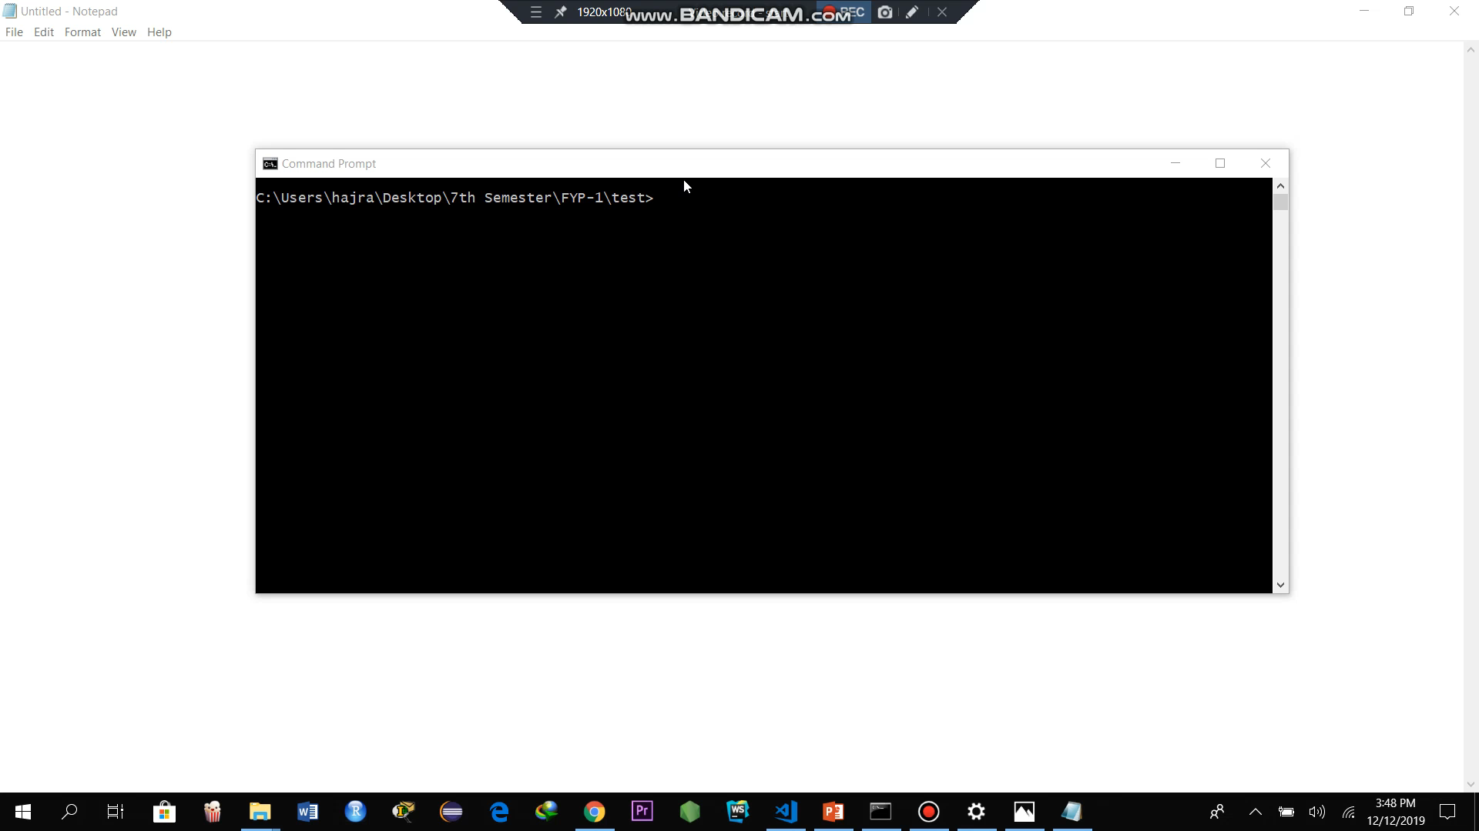

Slide 9
Any Questions?

Slide 10
Timeline
Data Scraping
Sep’19
Model Training
Jan’20 – Feb’20
3D Visualization
Mar’20 – Apr’20
Data Preprocessing
Oct’19
Algorithm for Segmentation
Nov’19 – Dec ‘19

Slide 11
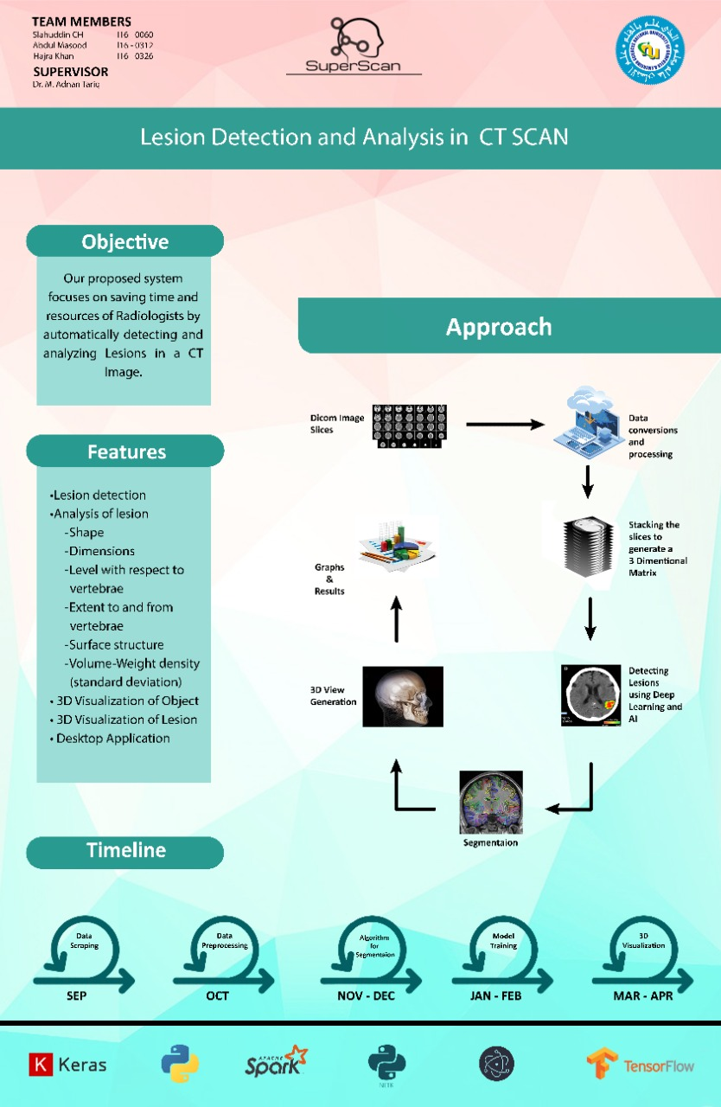
FYP Poster

